Slide 1
Supporting presentation for lecturers of Architecture/Civil Engineering
Chapter 11
Sustainability of Stainless Steels

Slide 2
Definitions
Greenhouse Gas (GHG): Emission Tonnes of CO2-eq /Tonne Steel ⁽¹⁾
Global Warming Potential: no unit Ratio of the abilities of different greenhouse gases (GHG) to trap heat in the atmosphere relative to that of carbon dioxide (CO2) ⁽²⁾. For instance, the GWP of Methane is 28 over a 100-year period. The primary GHG emitted in the steelmaking is CO2.
Primary Energy Consumption (GJ/T) GWP also called Energy Intensity : The energy consumption required to produce 1 tonne of primary material (such as steel). ⁽¹⁾
Gross Energy Requirement (GER): is the total amount of energy required for a product. ⁽⁸⁾
Materials Efficiency: Measures the amount of material not sent for permanent disposal, landfill or incineration, relative to crude steel production. ⁽¹⁾

Slide 3
Definitions
Life Cycle Inventory (LCI): a structured, comprehensive and internationally standardized method. It quantifies all relevant emissions and resources consumed and the related environmental and health impacts and resource depletion issues that are associated with the entire life cycle of products. ⁽³⁾
Life Cycle Cost (LCC): is a tool for assessing the total cost performance of an asset over time, including the acquisition, operating, maintenance, and disposal costs. ⁽⁴⁾
Life Cycle Assessment (LCA): is a tool to assist with the quantification and evaluation of environmental burdens and impacts associated with product systems and activities, from the extraction of raw materials in the earth to end-of-life and waste disposal. The tool is increasingly used by industries, governments, and environmental groups to assist with decision-making for environment-related strategies and materials selection.

Slide 4
Definitions
Safety Indicators:
Lost–Time Injury: The lost time injury frequency rate is the number of lost time injuries for each 1,000,000 working hours. ⁽¹⁾
Recycling Indicators:
Recycling rate how much of the end-of-life (EOL) material is collected and enters the recycling chain (as opposed to material that is landfilled). ⁽⁵⁾
Recycled content is defined as the proportion, by mass, of post - consumer and pre - consumer recycled material in a product. ⁽⁶⁾
Solid Waste Burden (SWB): includes mining waste, tailings, slag and power station ash

Slide 5
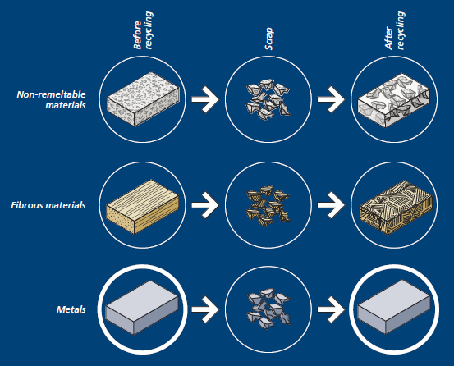
Comments on Indicators:
The recycling indicators do not take into account « downcycling».
Metals can be recycled without loss of quality.
Because metallic bonds are restored upon resolidification, metals continually recover their original performance properties, even after multiple recycling loops. This allows them to be used again and again for the same application.
By contrast, the performance characteristics of most non-metallic materials degrade after recycling. ⁽⁴⁵⁾

Slide 6
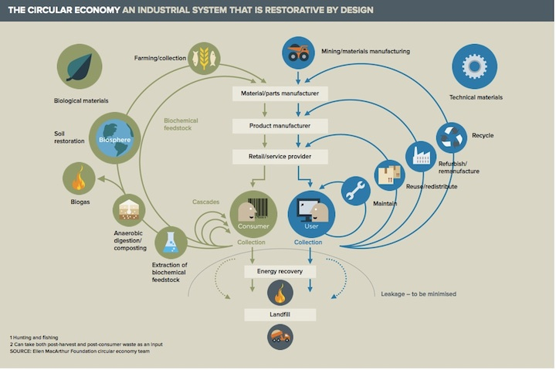
Downcycling is better than waste but still a long way from Circular Economy ^{(46,47)}
Collecting scrap metal for new metal products is one of the shortest loops
Circular economy is all about closing resource loops, mimicking natural ecosystems in the way we organize our society and businesses.
Notes:
http://www.circle-economy.com/circular-economy/
http://www.irishenvironment.com/iepedia/circular-economy/

Slide 7
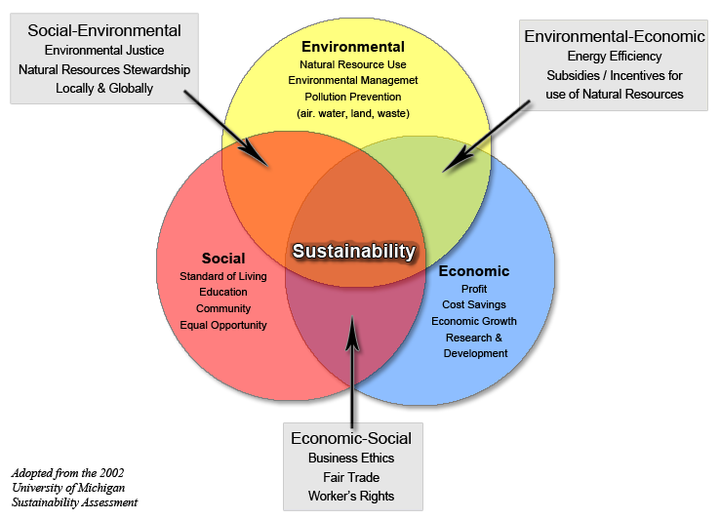
Sustainability
“Sustainability concerns the whole cycle of a product construction i.e. from raw material acquisition, through planning, design, construction and operations, to final demolition and waste management.” (Rossi, B. 2012) ⁹

Slide 8
Sustainability of stainless steel:
Environmental
Social
Economic

Slide 9
1. Environmental
Production ⇨ Use ⇨ Recycling ¹⁵
Life cycle of stainless steel in 2010. (YaleUniversity/ISSF stainless steel project 2013)

Slide 10
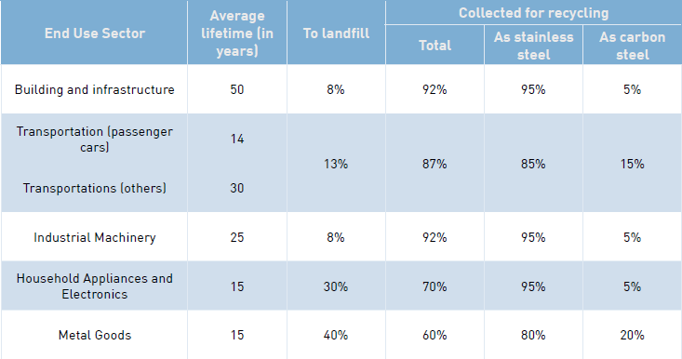
More on Use and Recycling ^{15, 23-25}

Slide 11
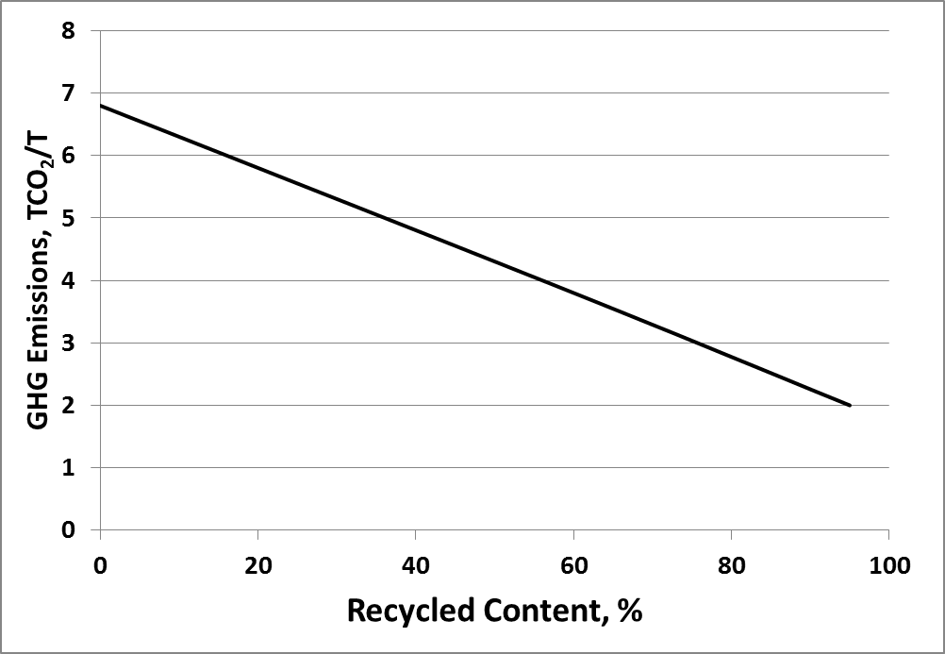
GHG Emissions vs. Recycled content ^{11, 12, 13, 14}
Present situation*
* The recycled content is limited by scrap availability

Slide 12
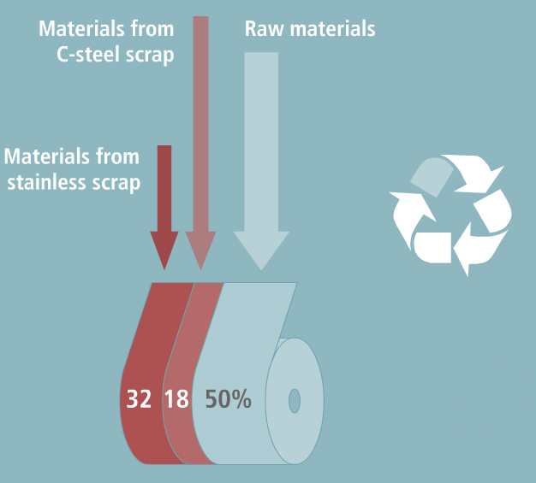
Recycled content of stainless steel

Slide 13
Greenhouse Gas Emissions for Stainless steel ⁽¹⁵⁾
3.3 ton CO₂/ ton Stainless Steel ⁽¹⁶⁾
Raw materials
Breakdown of emissions:
Raw Materials: ~58 %
Electricity Generation: ~19 %
Steelmaking: ~15%
(17)
Note: This does not take into account Nickel produced by the Nickel Pig Iron Route, for which the figure for Ni is believed to be about 3 times higher. China is currently the only country using Nickel Pig iron

Slide 14
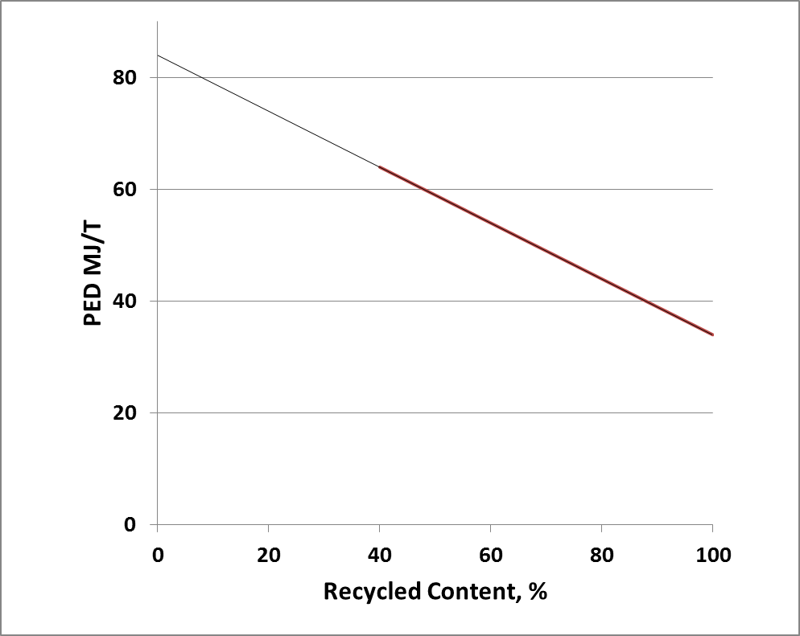
Primary Energy Demand ¹⁸
Present situation*
* The recycled content is limited by scrap availability

Slide 15
Environmental impacts for “cradle-to-gate” metal production ¹⁹
Metal | Process | GER (MJ/kg) | GWP (kg CO_{2e}/kg) | AP (kg SO_{2e}/kg) | SWB (kg/kg)
Stainless Steel | Electric furnace and Argon – Oxygen Decarburization | 75 | 6.8 | 0.051 | 6.4
Steel | Integrated route (BF and BOF) | 23 | 2.3 | 0.020 | 2.4
Aluminium | Bayer refining, Hall-Heroult smelting | 361 | 35.7 | 0.230 | 16.9
Copper | Smelting/converting and electro-refining | 33 | 3.3 | 0.040 | 64
 | Heap leaching and SX/EW | 64 | 6.2 | - | 125
GER: Gross Energy Requirement GWP: Global Warming
Potential AP: Acidification Potential SWB: Solid Wast Burden

Slide 16
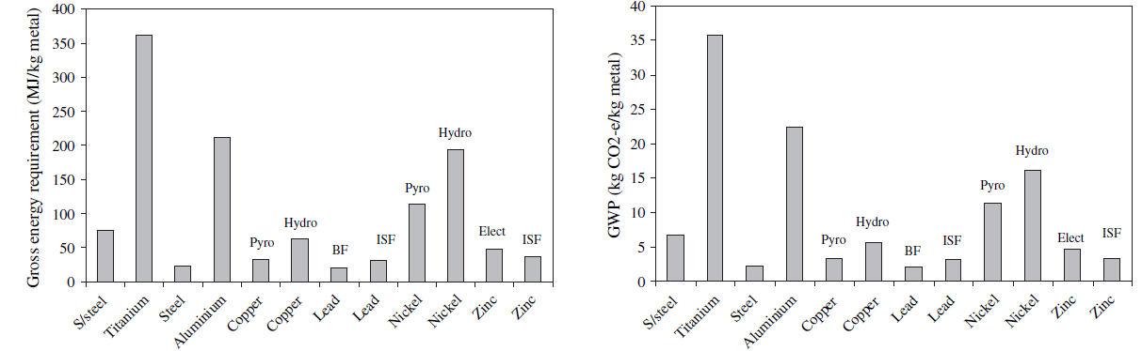
Environmental impacts for “cradle-to-gate” metal production²⁰
Gross Energy Requirement for “cradle-to-gate” production of various metals
Global Warming Potential for “cradle-to-gate” production of various metals
(without any recycled content)

Slide 17
Materials are not used in the same quantity for a similar function or service ²¹
Example:
Indicative environmental potential impacts for 3 different wall finishes.
Material | PED (MJ/m²) | GWP (Kg _{CO2-eq.} /m²) | End-of-Life (EOL) scenario
High pressure laminate such as Trespa® | 759.3 | 23.9 | 50% reuse + 50% landfill
Generic stucco | 144.2 | 12.7 | Not recycled
Stainless Steel 0.5mm | 140.5 | 7.2 | RR = 95%
Stainless Steel 0.8 mm | 191.7 | 11.3 | RR = 95%

Slide 18


Materials Efficiency
Reduce:
the quantity of raw material to produce Stainless Steel. (40%), consequently the CO2 emission decreases.
Reuse:
The durability of stainless steels makes reuse very important.
Examples: Bottles, mugs, cups, straws…
Single use of plastics is increasingly banned

Slide 19
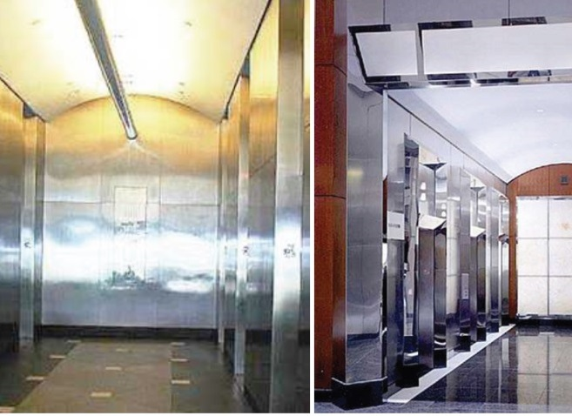
Example: Reuse ²²
The Stainless Steel panels had become dirty and scratched after about 50 years use. During renovation of the lobby, the 50-year old stainless steel panels were removed, cleaned, refinished and reused.

Slide 20
Materials Efficiency
Recycle:
Stainless Steel is 100% recyclable, all the scrap collected (82%) is reused.
Zero-waste stainless steel production ⇨ Slag and dust are the main by-products and waste which result from steelmaking. Example: Slag products can be used in the asphalt for road construction.

Slide 21
LEED* and Stainless LCI Data
U.S. Green Building Council released “*Leadership in Energy and Environmental Design” version 4 (LEED v4) in 2013
  New version includes changes that are favorable to stainless:
    Greater emphasis on service life
    Tighter requirements on VOC** emissions (a problem for some materials such as plastics)
U.S. General Services Administration (manages US government buildings and properties) recently endorsed the use of LEED
  State and local governments increasingly require LEED or similar certifications for new buildings or modifications
** VOC: Volatile Organic Compounds: for Stainless Steel, very small emissions during processing&fabrication (no data available yet) and none during use

Slide 22
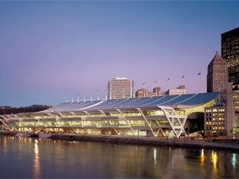

Sustainable building with Stainless steel - The David L. Lawrence Convention Center, Pittsburgh (2003) ²⁶
Stainless steel roof:
S30400 stainless steel
Measuring: 280 × 96m
Sheathed with 23,000m2 of 0.6mm (24-gauge), weighing about 136 tonnes.

Slide 23
Sustainable building with Stainless steel: the Gold LEED status
The Gold LEED (Leadership in Energy and Environment Design) status recognizes:
  the centre’s brownfield redevelopment
  accommodation of alternative transportation
  reduced water use
  efficient energy performance
  use of materials that emit no or low amounts of toxins
  innovative design

Slide 24
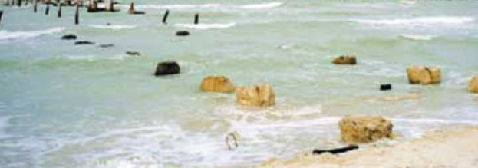
Sustainable Civil Works with Stainless:
The Progreso Pier ⁽²⁷⁾
At Progreso, Mexico, a pier was built in 1970. The marine environment made the carbon steel rebar corrode – the structure failed.

Slide 25
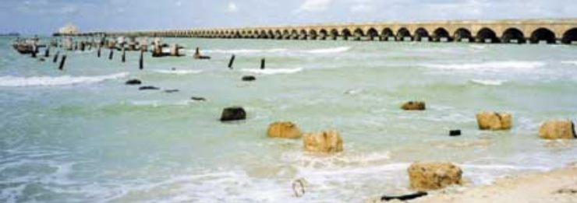
Sustainable Civil Works with Stainless:
The Progreso Pier
The neighbouring pier had been erected in 1937 – 1941 using stainless steel reinforcement.

Slide 26

Sustainable Civil Works with Stainless:
The Progreso Pier
Ever since then, it has been maintenance free and remained in pristine condition.

Slide 27
2. Social
A sustainable material does not harm the people working to produce it, or who handle it during its use, recycling and ultimate disposal.
Stainless steel is not harmful to people during either its production or use. For these reasons, stainless steels are the primary material in medical, foodprocessing, household and catering applications.
The safety like injury-free and healthy workplace of the employees is the key priority for the stainless steel industry.
Stainless steel also improves the quality of life by making technical advances possible. For example the installations that provide us with clean drinking water, food and medication would not be nearly as hygienic and efficient as they are without stainless steel.

Slide 28
3. Economic
300,000
People directly or indirectly employed in the stainless steel industry worldwide
US$130 billion
Turnover of the global stainless industry, 2010
5,85% average increase in production each year since 1970
100%
recyclable
forever
45 million tonnes stainless steel fabricated in 2016

Slide 29
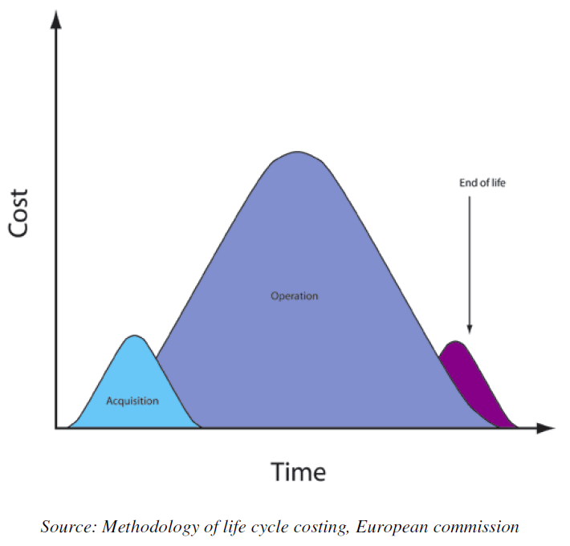
Life Cycle Costing (LCC) ³⁰
LCC is the cost of an asset throughout its life cycle, while fulfilling the performance requirements (ISO 15686-5).
LCC is the sum of all cost related to a product incurred during the life cycle:
conception ⇨ fabrication ⇨ operation ⇨ end-of-life

Slide 30
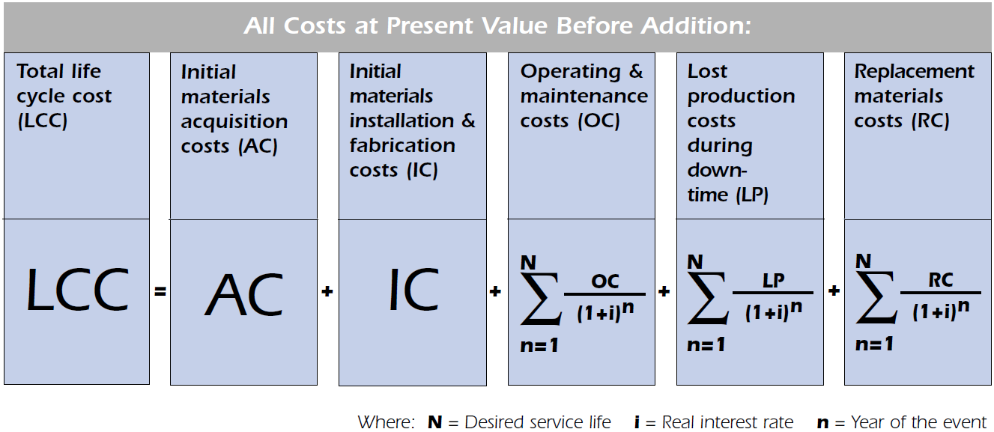
Life Cycle Costing (LCC)
LCC is a mathematical procedure helping to make investment decisions and/or compare different investment options.

Slide 31
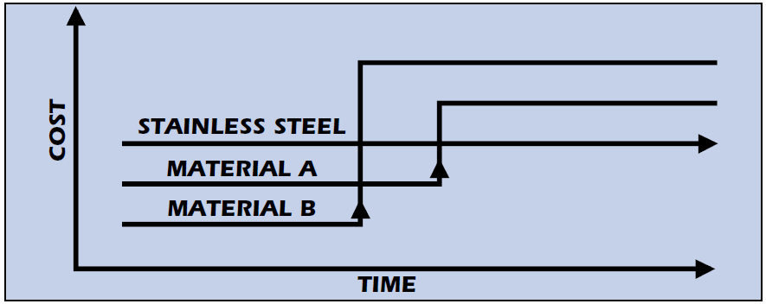
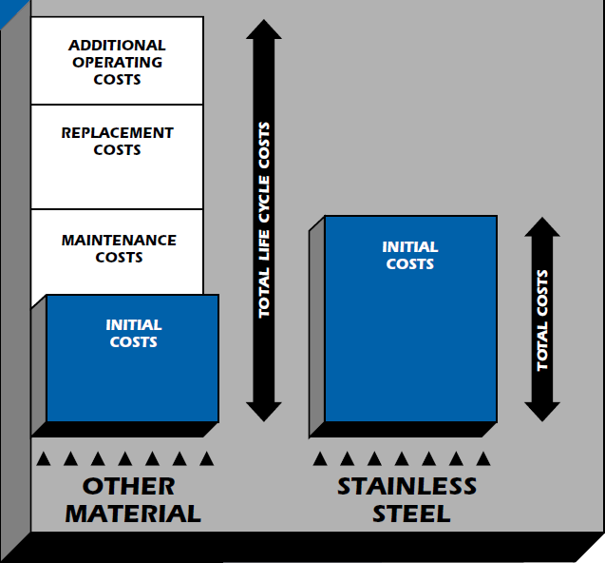
Stainless steel is not expensive if the life cycle cost is taken into account ³¹
The cost of other materials substantially increases over time while the cost of stainless steel normally remains constant.
“Corrosion of metals costs the United States economy over $300 billion annually. It is estimated that about one-third of this cost ($100 billion) is avoidable by use of best known technology. This begins with design, selection of anti-corrosion materials like stainless steel, and quantifying initial and future costs including maintenance by Life Cycle Costing/LCC techniques. ”

Slide 32
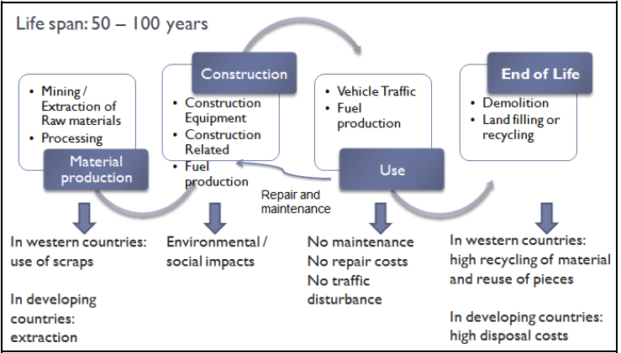
LCC Example: Bridges
Example of stainless steel bridge life cycle phases and its impacts on the environment in different areas of the world

Slide 33
LCC Example: Bridge
Life cycle cost summary of a reinforced concrete highway bridge ³²
Description | Carbon Steel | Epoxy C.S. | Stainless Steel
Material Costs | 8,197 | 31,420 | 88,646
Fabrication Costs | 0 | 0 | 0
Other installation costs | 15,611,354 | 15,611,345 | 15,611,354
Initial Costs | 15,619,551 | 15,642,774 | 15,700,000
Maintenance | 0 | 0 | 0
Replacement | 256,239 | 76,872 | -141
Lost Production | 2,218,524 | 2,218,524 | 0
Material related | 0 | 0 | 0
Operating Costs | 2,247,763 | 2,295,396 | -141
Total LCC (USD) | 18,094,314 | 17,937,170 | 15,699,859

Slide 34
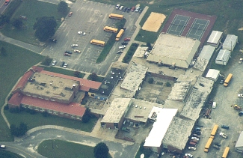
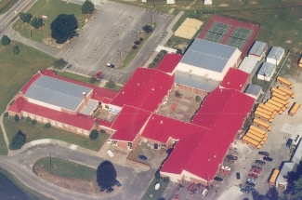
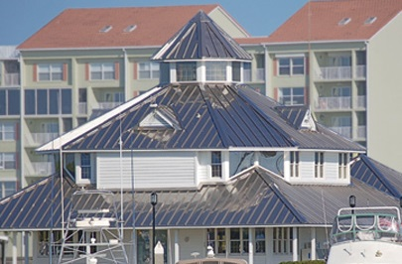
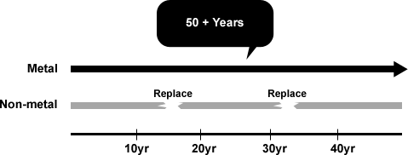
LCC Example: Roofing
Life cycle cost of a roof ^{33, 34, 35}
Conventional roofing systems, ~30 years | metal roofing system, 40-50 years | Stainless steel roofing system , more than 50 years

Slide 35
LCC Example: Roofing
Cost comparison of 0.6 mm coated galvanised carbon steel and 0.4 mm stainless steel grade 1.4401: Due to the mechanical properties of stainless steels, the material thickness can be reduced to 0.5 or 0.4 mm, providing a lighter weight (4,68 kg/m² for 0.7 mm coated carbon steel, 3,12 kg/m² for stainless steel). While coated carbon steel has a life expectation of 15 to 20 years, the service life of a stainless steel roof is generally that of the building.

Slide 36
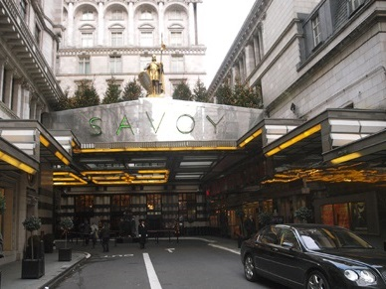

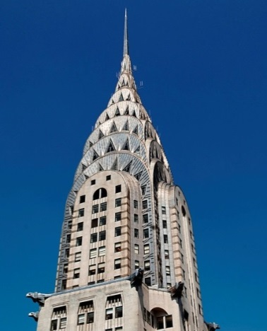
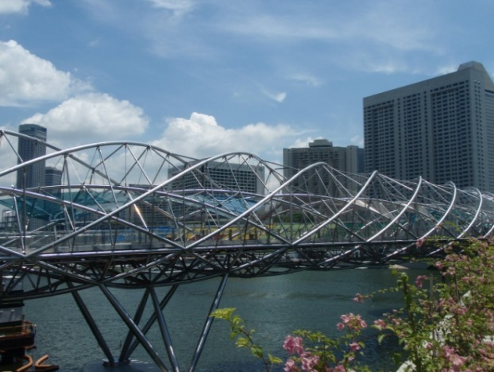
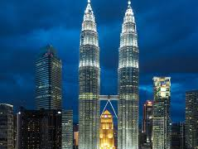
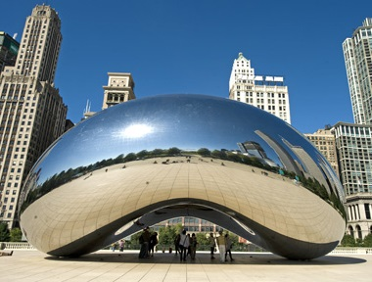
Timeless Stainless Steel Architecture⁴³
Savoy hotel, London, 1929 | Empire State building, New York, 1931 | Chrysler Building, New York, 1930
Helix Bridge, Singapore, 2011 | Petronas Towers, Kuala Lumpur | Cloud Gate “Jelly Bean”, Chicago, 2008

Slide 37

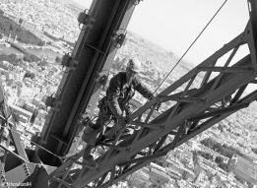
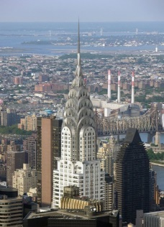

Comparison of Life Cycle Costing ^{36, 37, 38, 39, 40}
Monument | Completed | Material | Height | Maintenance
Eiffel Tower – Paris | 1889 | Wrought iron | 324m | Every 7 years. Every painting campaign lasts for about a year and a half (15 months). 50 to 60 tons of paint, 25 painters, 1500 brushes, 5000 sanding disks and 1500 sets of work clothes.
Chrysler Building (Roof and Entrance) – New York | 1930 (roof 1929) | Austenitic Stainless Steel (302) | 319m | Twice in 1951, 1961. The 1961 cleaning solution is unknown. A mild detergent, degreaser and abrasive were used in 1995.
Notes:
Please remember that
The Eiffel tower was built before stainless steel was invented!
It was supposed to be a temporary structure, but the public loved it !

Slide 38
What makes Stainless Steel “Green”?
Stainless Steel Environmental Evaluation ⁴¹
What is the recycled content? | 60%
Is it 100% recyclable? | Yes
Does it provide long life? | Yes (reduces maintenance and disposal frequency)
Is there recycled content? | Yes (both post-consumer and post-industrial)
Is construction waste diverted from landfills? | Yes (high scrap value and product reuse potential)
Can it be salvaged and reused during renovations? | Yes
Is it a low emitting material? | Yes (no coatings = zero emissions)
Can it help to improve indoor air quality? | Yes (no volatile organic compounds (VOCs), bacteria removal, corrosion resistant ductwork)
Does it help to avoid the use of toxic materials? | Yes (long lasting termite barriers, minimal roof run-off)
Can it save energy? | Yes (sunscreens, roofing, balcony inserts)
Can it help generate clean energy? | Yes (solar panels, power plant scrubbers)
Can it conserve water? | Yes (corrosion and earthquake resistant water lines and tanks)
Can reflective panels add natural light? | Yes
Can it extend the life of other materials? | Yes (stone and masonry anchors, fasteners for wood and metals sch as Al)

Slide 39
CONCLUSIONS
Sustainability is a big and important challenge for the future in the stainless steel industry. Efforts has been done to reduce it Carbon footprint by increasing recyclability and improving processes.
Stainless steel have a combination of properties which should be taking account in the decision making process at the design state:
  Mechanical properties
  Corrosion resistance properties
  Fire resistance
  Recyclability
  Long life
  Low maintenance costs
  Neutrality and Hygienic
  Aesthetics
  Neutrality to rain water

Slide 40
References and Sources (1/3)
https://www.worldsteel.org/en/dam/jcr:a5cd469c-89cb-4d57-9ad8-13a0d86d65f0/Sustainability+indicator+definitions+and+relevance.pdf
http://ghginstitute.org/2010/06/28/what-is-a-global-warming-potential/
http://eplca.jrc.ec.europa.eu/uploads/ILCD-Handbook-General-guide-for-LCA-DETAILED-GUIDANCE-12March2010-ISBN-fin-v1.0-EN.pdf
https://www.gsa.gov/portal/content/101197
Recycled content is defined in accordance with the ISO Standard 14021 -Environmental labels and declarations - Self declared environmental claims (Type II environmental labeling).
http://www.greenspec.co.uk/building-design/recycled-content/
http://www.fao.org/docrep/u2246e/u2246e02.htm
B. Rossi. Stainless steel in structures: Fourth International Structural Stainless Steel Experts Seminar. Ascot, UK. 6-7 December 2012.
Source: Yale University/ISSF Stainless Steel Project, 2013
B. Rossi. ArcelorMittal International Scientific Network in Steel Construction Sustainability Workshop and Third Plenary Meeting, Bruxelles, 2010.
B. Rossi. Stainless steel in structures: Fourth International Structural Stainless Steel Experts Seminar. Ascot, UK. 6-7 December 2012.
T.E. Norgate, S. Jahanshahi, W.J. Rankin. Assessing the environmental impact of metal production processes. Journal of Cleaner Production 15 (2007), 838-848.
http://www.worldstainless.org/Files/issf/Animations/Recycling/flash.html

Slide 41
References and Sources (2/3)
ISSF https://www.worldstainless.org/Files/issf/non-image-files/PDF/ISSF_Stainless_Steel_and_CO2.pdf. Data from European and Japanese ISSF members
Based on 2013 data, including 60% scrap content (and therefore 40% new materials) and energy contribution to GHG
Data provided by ISSF, estimates calculated by SCM. Includes 60% recycled content
ISSF www.worldstainless.org. Data from European anf Japanese ISSF members
T.E. Norgate, S. Jahanshahi, W.J. Rankin. Assessing the environmental impact of metal production processes. Journal of Cleaner Production 15 (2007), 838-848.
T.E. Norgate, S. Jahanshahi, W.J. Rankin. Assessing the environmental impact of metal production processes. Journal of CleAner Production 15 (2007), 838-848.
B. Rossi. Stainless steel in structures: Fourth International Structural Stainless Steel Experts Seminar. Ascot, UK. 6-7 December 2012.
C. Houska. Sustainable Stainless Steel Architectural.
http://www.worldstainless.org/Files/issf/Animations/Recycling/flash.html
https://www.drkarenslee.com/comparing-reusable-bottles-stainless-steel-glass-plastic/
Yale University/ISSF Stainless Steel Project, 2013
The Greening of a Convention Centre. Nickel, Volume 23, Number 3, June 2008, 6-9.
https://www.nickelinstitute.org/Sustainability/LifeCycleManagement/LifeCycleAssessments/LCAProgresoPier.aspx
International Stainless Steel Forum www.worldstainless.org
World Steel Association
A. Dusart, H. El-Deeb, N. Jaouhari, D. Ka, L.Ruf . Final Report ISSF Workshop. Université Paris 1 Panthéon-Sorbonne, 2011.

Slide 42
References and Sources (3/3)
http://www.ssina.com/download_a_file/lifecycle.pdf
https://www.nickelinstitute.org/nickel-magazine/nickel-magazine-vol-31-no1-2016/
www.worldstainless.org/Files/issf/non-image-files/PDF/Euro_Inox/RoofingTech_EN.pdf
http://www.ametalsystems.com/RoofLifecycleCostComparison.aspx
http://www.metalroofing.com/v2/content/guide/costs/life-cycle-costs.cfm
https://www.toureiffel.paris/en
https://en.wikipedia.org/wiki/Eiffel_Tower
http://corrosion-doctors.org/Landmarks/Eiffel.htm
http://en.wikipedia.org/wiki/Chrysler_Building#
Nickel Development Institute. Timeless Stainless Architecture. Reference Book Series No 11 023, 2001
C. Houska. Sustainable Stainless Steel Architectural. Construction Canada, September 2008, 58-72.
Nickel Development Institute. Timeless Stainless Architecture. Reference Book Series No 11 023, 2001
G. Gedge. Structural uses of stainless steel — buildings and civil engineering. Journal of Constructional Steel Research 64 (2008), 1194–1198.
http://www.metalsforbuildings.eu/
http://www.circle-economy.com/circular-economy/
http://www.irishenvironment.com/iepedia/circular-economy/

Slide 43
Thank you

Slide 44
Appendix
Recycling of other materials
This is a complex issue
This aims at giving a few ideas on other materials,
for comparison purposes
Sources are indicated

Slide 45
More on recycling: Cement and Concrete
www.wbcsdservers.org/wbcsdpublications/cd_files/datas/business-solutions/cement/pdf/CSI-RecyclingConcrete-FullReport.pdf
20% maximum of crushed concrete can be used in new concrete.
  as aggregates only, not as cement
  the concrete thus produced is a lower quality product, not suitable for all applications
It seems that most of the concrete after demolition goes into road beds and landfill (no detailed figures are available)
Crushing old concrete and transportation are the main operations in recycling, to be compared with getting aggregates locally.
0verall, recycling involves everytime downcycling.
Re-using concrete as blocks after demolition is only marginal today, but could provide the shortest route to re-use without downcycling. Not easy to implement, though!
Notes:
http://www.wbcsdcement.org/pdf/CSI-RecyclingConcrete-Summary.pdf

Slide 46
More on recycling: plastics
http://www-g.eng.cam.ac.uk/impee/?section=topics&topic=RecyclePlastics&page=materials
In-house scrap (generated at the source of production) is near-100% recycled already
Recycling of used plastics is a big problem:
  Collection is time-intensive, so expensive
  Sorting of mixed plastic waste is difficult – contamination is inevitable.
  Removing labels, print, all but impossible at 100% success rate
  Contamination of any sort compromises re-use in “hi-tech” applications
=> recycled plastic (apart from in-house) is reused in lower- grade applications (downcycling): PET: cheap carpets, fleeces; PE and PP: block board, park benches.
=> and/or will be eventually burned or worse landfilled or even worse left floating on oceans.
Notes:
http://www.benefits-of-recycling.com/recycleplastics/
http://www.solwayrecycling.co.uk/recycled-plastic-products

Slide 47
More on recycling: Wood (from ABC*)
The best recycling option is, of course, to re-use it. It appears that there is a lot of effort going on to collect, recondition and re-manufacture timber and other wood products. How much is re-used is not clear.
Untreated timber and wood has found an increasing number of new uses: land and horticultural products, animal beddings, equestrian arena surfaces …
Treated timber& wood (the chemical treatment prevents rot, fungi, insects and UV damage) contains harmful chemicals, which strongly limit their use. The largest use has been so far particle board manufacture, but what happens to these boards at their end of life remains unclear.
It should be pointed out that the overall deforestation going on on the planet does not speak for unlimited sources of new wood, especailly in northern countries in which it takes a century for a tree to grow to its full size
Cutting down a forest and re-planting trees leaves the topsoil open to erosion for a while, and destroys the ecosystem in the harvested area possibly beyond self repair.
Last, it has been argued that the carbon neutrality has been achieved only when the re-planted forest is fully grown….some 30 years or more later!
https://dtsc.ca.gov/toxics-in-products/treated-wood-waste/
https://woodrecyclers.org/about-waste-wood/wood-recycling-information/
http://en.wikipedia.org/wiki/Wood_preservation
http://www.wasteminz.org.nz/wp-content/uploads/Scott-Rhodes.pdf
http://www.brighthub.com/environment/green-living/articles/106146.aspx
*ABC: Architecture, Building and Construction
Notes:
http://www.solidwastedistrict.com/statistics/wood.html
http://www.woodrecyclers.org/recycleapplication.php
http://en.wikipedia.org/wiki/Wood_preservation

Slide 48
Thank you!
Test your knowledge of stainless steel here:
https://www.surveymonkey.com/r/3BVK2X6

